Slide 1
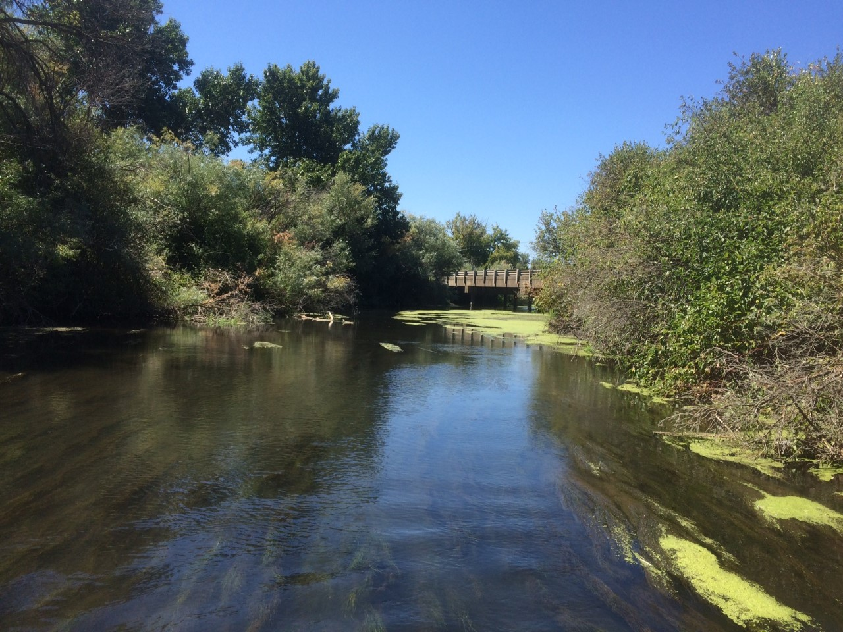



The influence of irrigation flows on microbial and algal nutrient limitation
Sarah S. Roley (@ssroley)
Clay Arango
Alex Alexiades

Slide 2
Irrigated Agriculture
Excess N and P exported downstream
USGS 2004

Slide 3
Irrigation season
River → Field → River
Seasonal differences in hydrology, [nutrient]
Non-Irrigation season
Groundwater → River

Slide 4
What limits microbial and algal production in irrigated systems?
Base of the food web
Assimilatory uptake often major pathway for nutrient removal
What is the capacity for nutrient uptake?

Slide 5
Capacity for nutrient uptake influenced by supply: demand
Demand: ↑ with sun, temp
Supply: ↑ with irrigation, may vary with nutrient
Covino et al. 2018

Slide 6
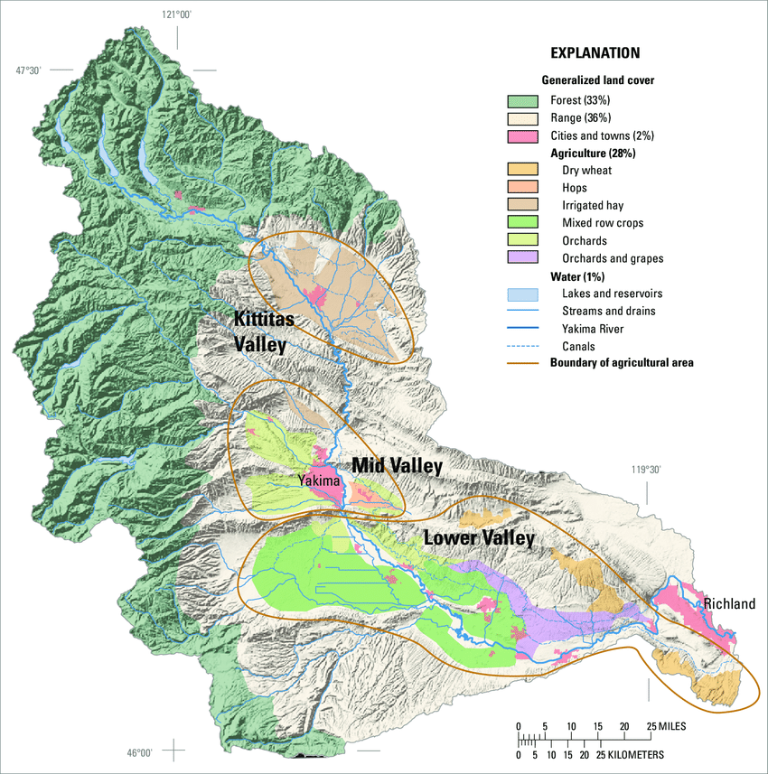
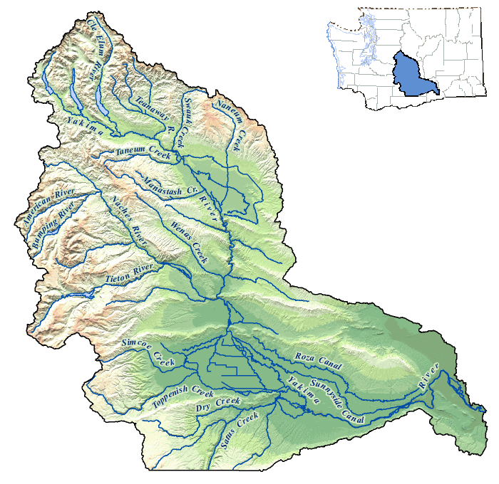
Study sites – tributaries of the Yakima River
irrigated hay
study sites
orchards & hops
orchards & grapes
mixed row crops
dry wheat

Slide 7
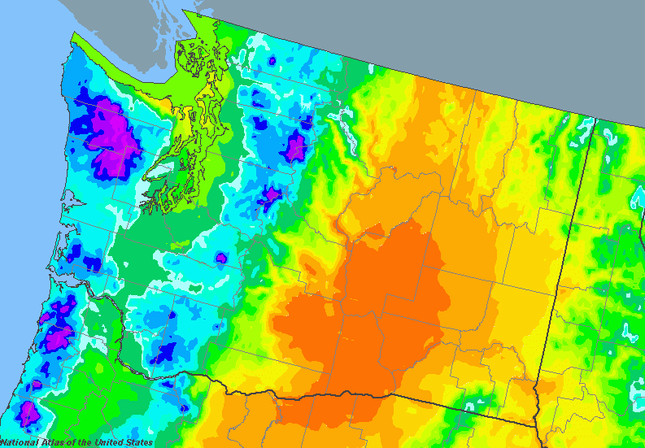
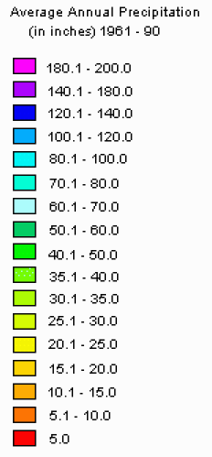

Slide 8
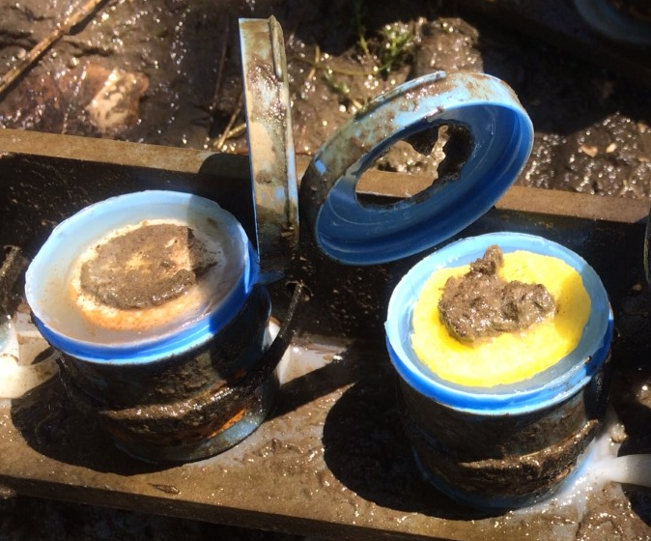
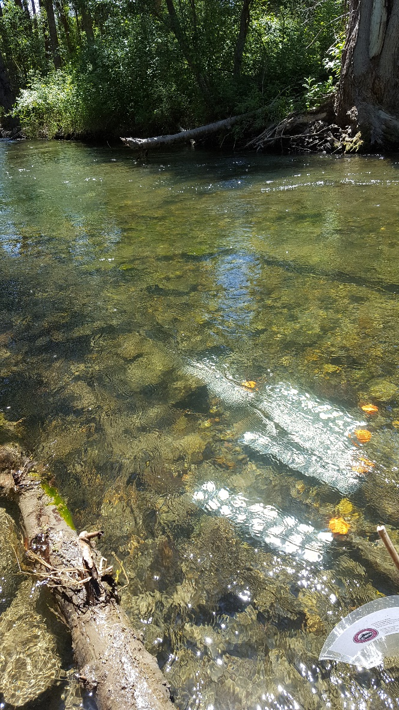
Methods – Nutrient-Diffusing Substrates (NDS)
Glass – for primary producers
Cellulose – for heterotrophs
Agar + nutrients (N, P, Si, or combination)

Slide 9
[Nitrogen] ↑ downstream, with irrigation
Irrigation
Non-irrigation
NH₄⁺
NO₃⁻
↑ [N] coincident with ↑ demand
No data
upstream → downstream

Slide 10
[DOC] varies with season, location
Non-irrigation
Irrigation
upstream → downstream

Slide 11
Nutrient response ratios
NRR = GPP/GPPcontrol

Slide 12
Gross primary production
Irrigation
Non-irrigation
N
P
Si
NP
NSi
PSi
NPSi
Reecer
Wenas
Satus
Reecer
Wenas
Satus
Ahtanum
Toppenish
Ahtanum
Toppenish
upstream → downstream
Notes:
again, no limitation in the fall = limited capacity for taking up additional N and P
Likely limited by light and temp
Summer: site variation. Reecer not responding to inputs, probably also light limited (shaded stream)
Wenas can respond to P, but Toppenish responded primarily to Si
Ahtnaum and Satus: bit of a mystery – not particularly shaded, but doesn’t respond even to the combination of nutrients. Something else limiting?
Overall: some sites have the ability to take up additional nutrients, but others do not

Slide 13
Community respiration
Irrigation
Non-irrigation
N
P
Si
NP
NSi
PSi
NPSi
Reecer
Wenas
Satus
Reecer
Wenas
Satus
Ahtanum
Toppenish
Ahtanum
Toppenish
upstream → downstream
Notes:
No nutrient limitation during fall – temp likely limiting
Fall: if influx of nutrients in the fall, uptake unlikely. Relevant: nutrients coming in through groundwater (slow pathways)
Irrigation season: site variation
common: co-limitation of NPSi
If additional N and P enter the system, will also need Si for biota to respond
Wenas: capacity to take up more N
Toppenish: can take up more N, but only if Si present

Slide 14
Conclusions/Hypotheses
↑ [N] coincident with ↑ potential uptake
Irrigation season: site variation; some potential for ↑ N & P removal
Non-irrigation season: light and temperature likely limit uptake

Slide 15
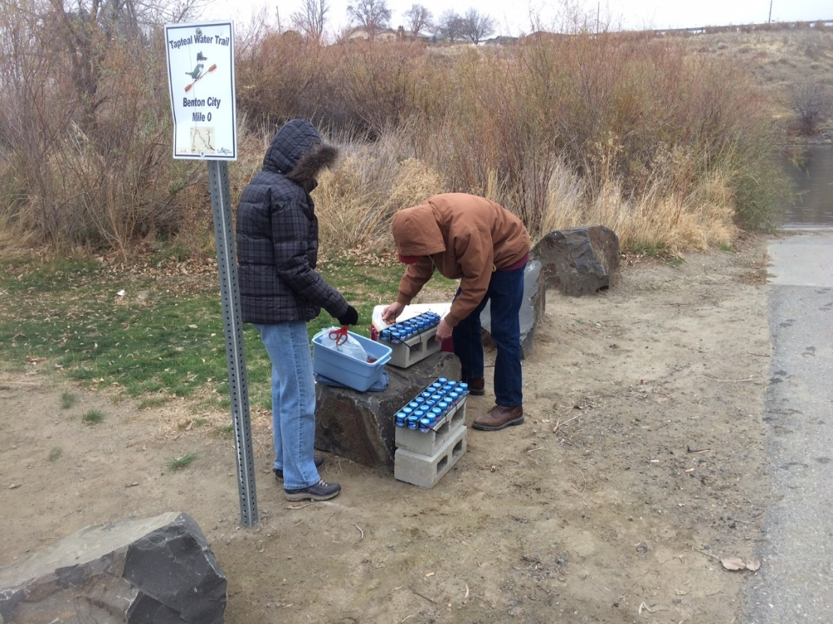
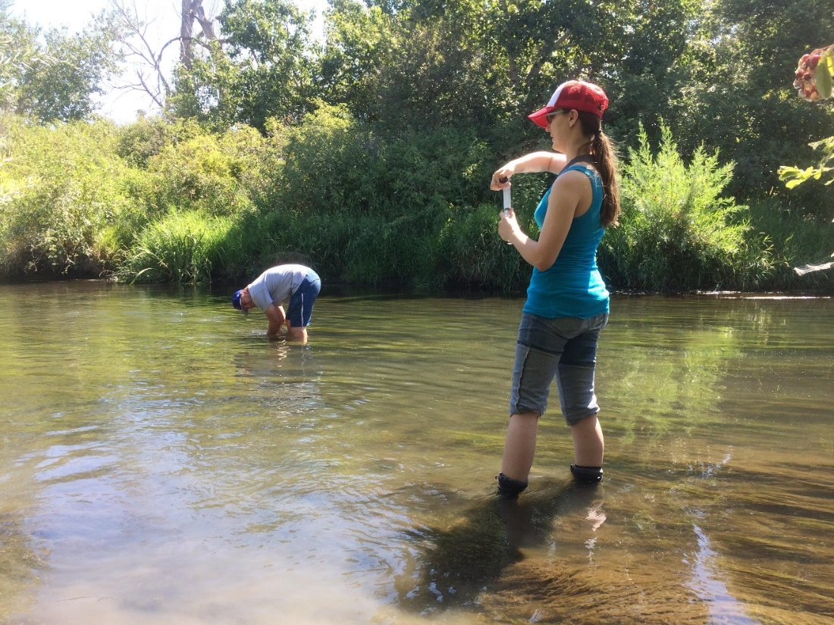
Acknowledgements
contact: sarah.roley@wsu.edu, @ssroley
Site access: Yakama Nation
Field and lab help: Rhenton Brimberry, Cassandra Elkins, Alifya Saify, Allison Staten, Noelle Scofield, Allyn Roley, Susan Roley

